Slide 1


Practical - Exercise
Orientation Programme - Batch 21 Faculty of Information Technology University of Moratuwa
Preliminaries of Web Technologies

Slide 2

Welcome
Group - 81
We are from

Slide 3


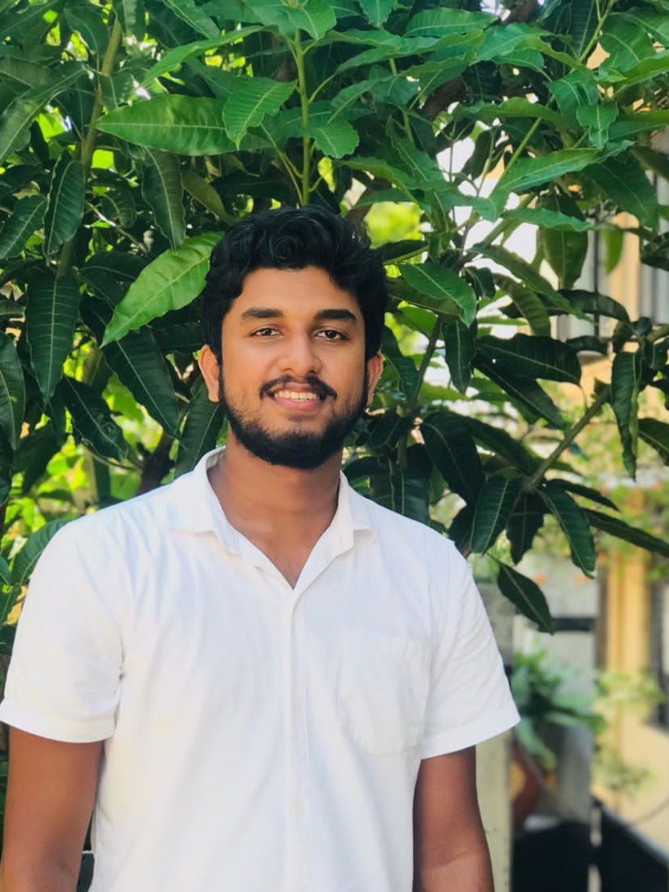
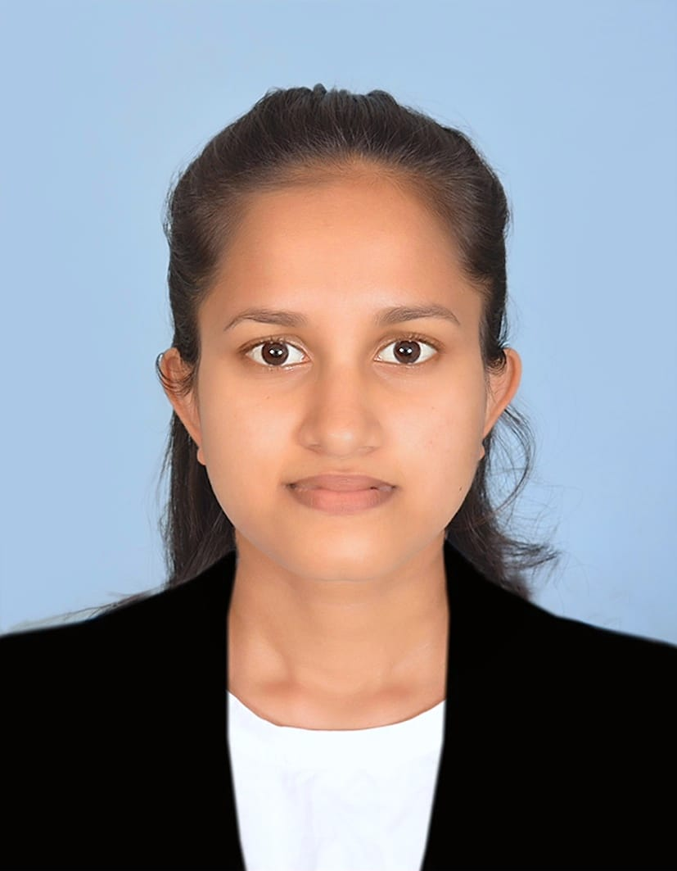
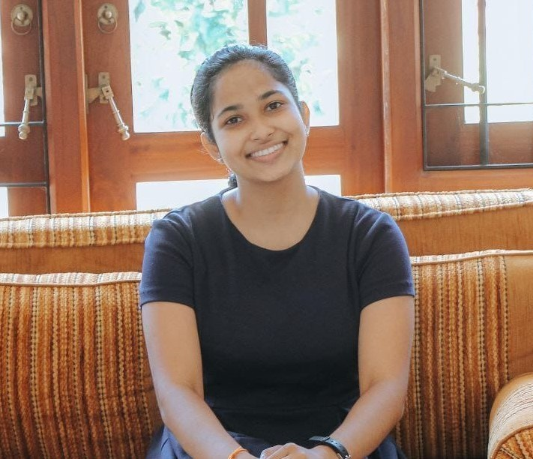
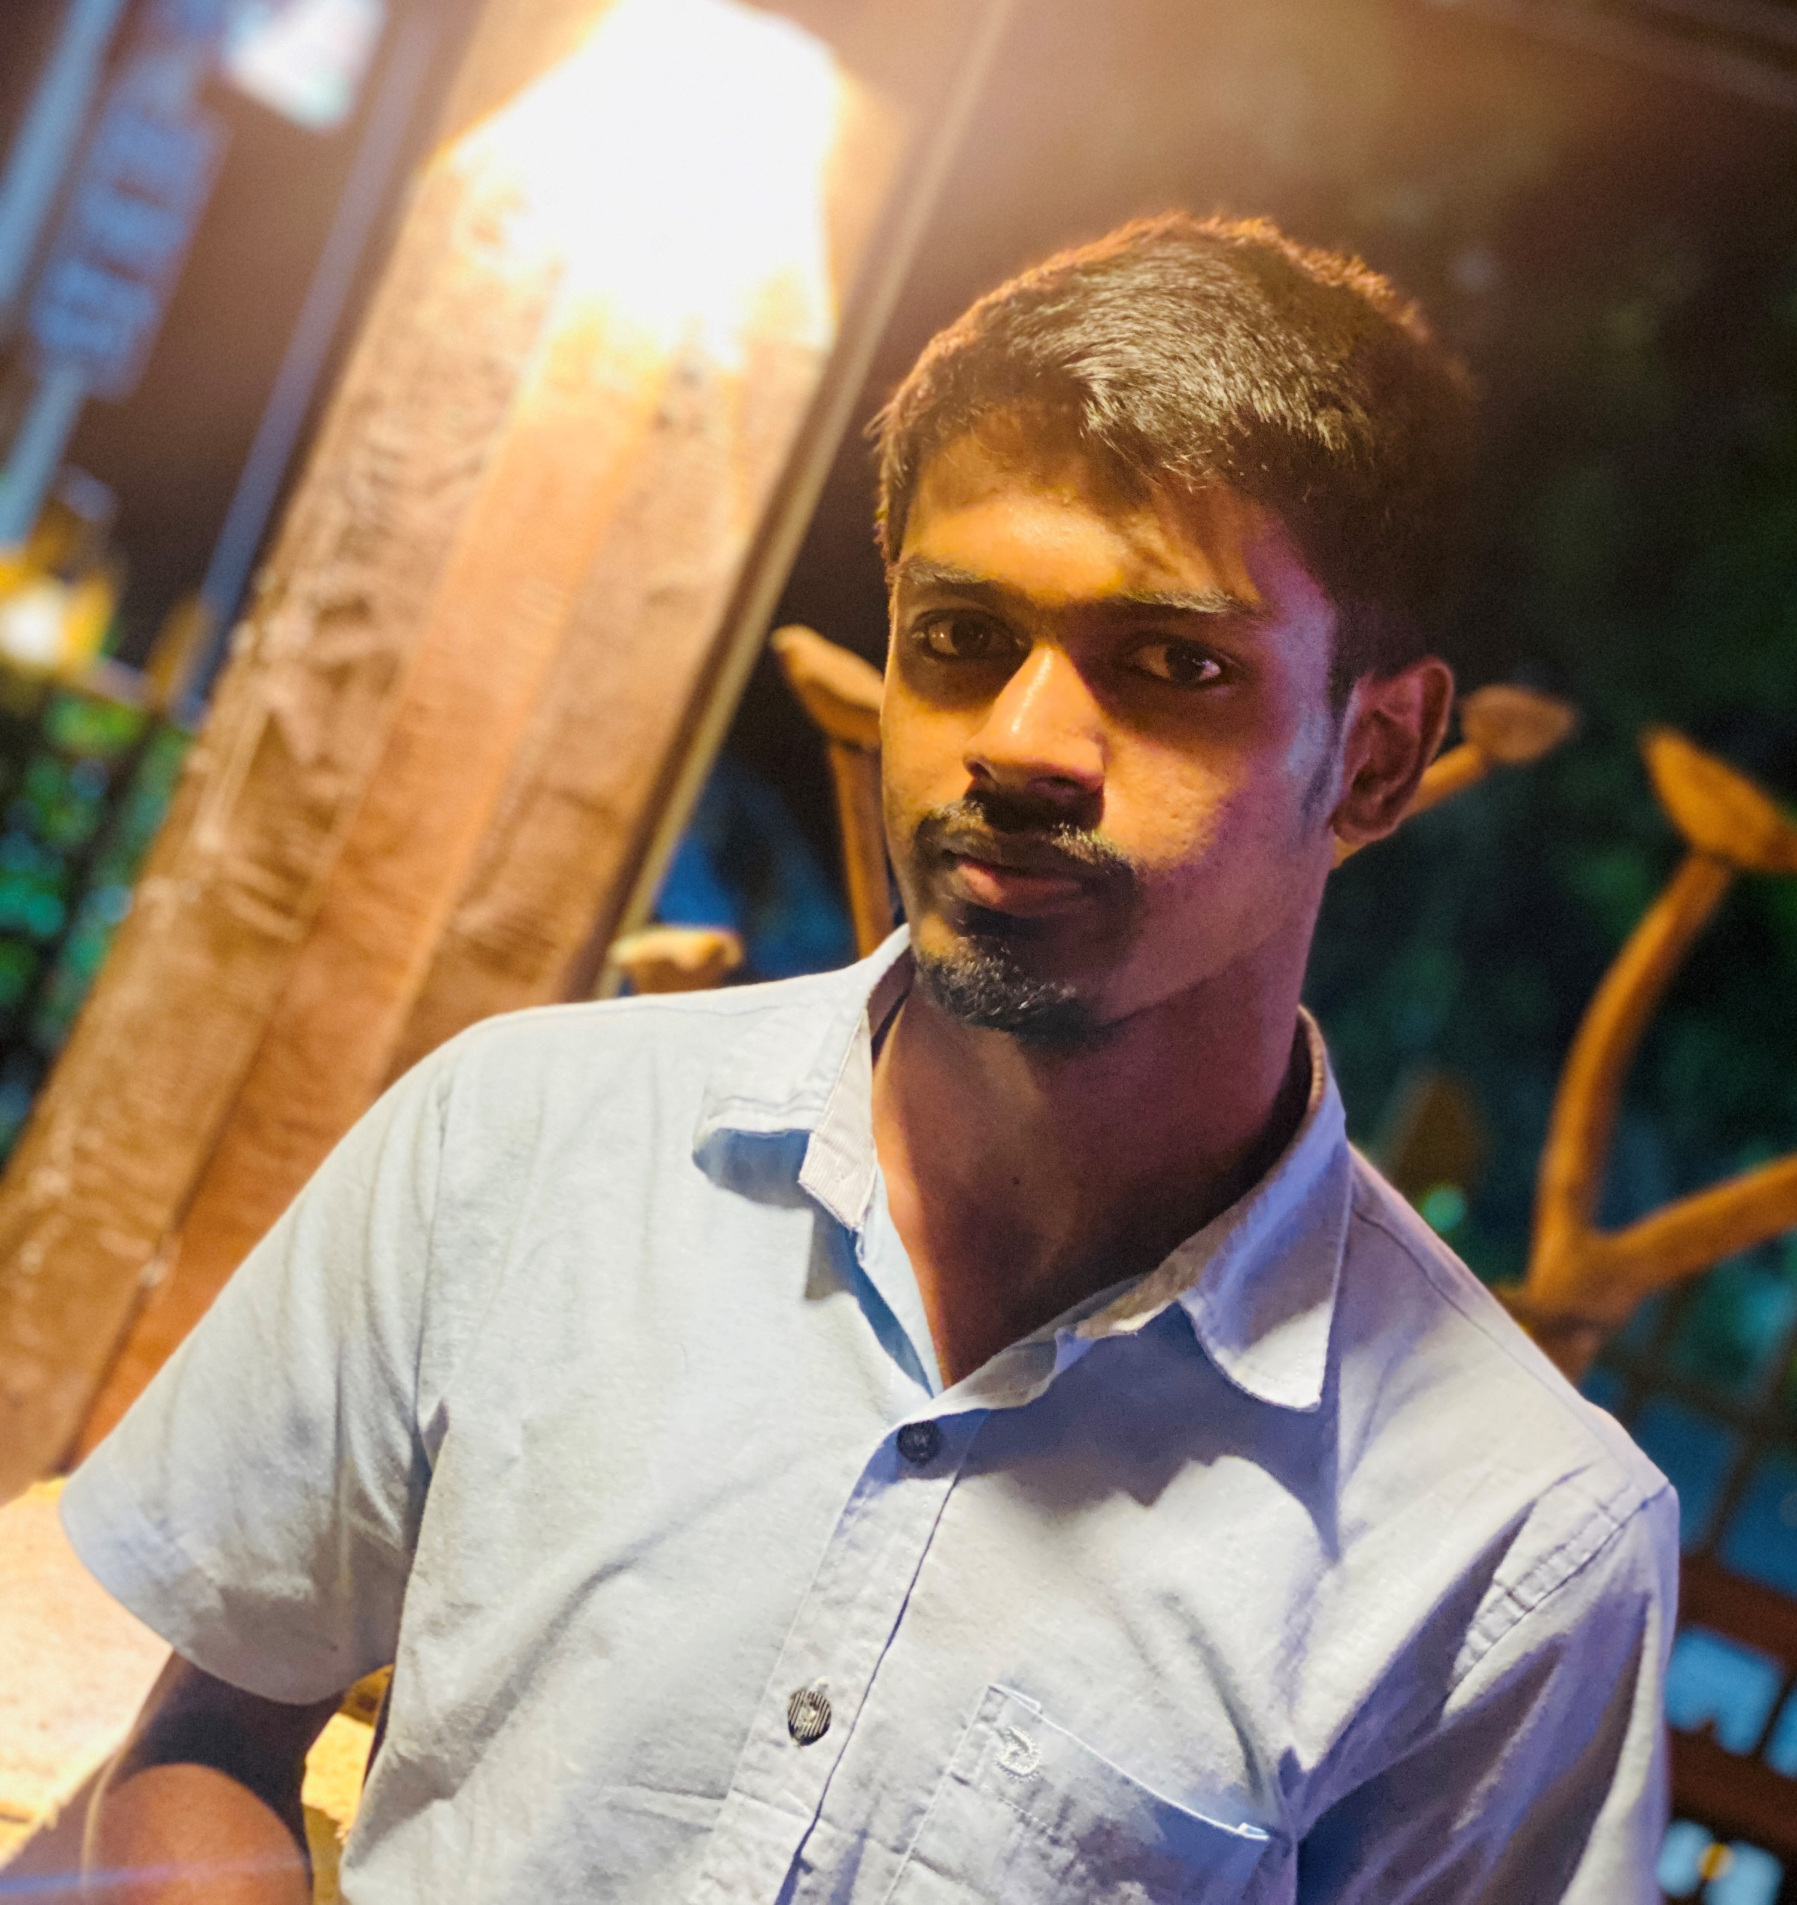
Team Members
Malintha Kavinda
Mihiliya Maheshika
Amasha Shivoni
215062R
215072X
215123G
Kasun Jayasanka
215094P
Team Leader

Slide 4

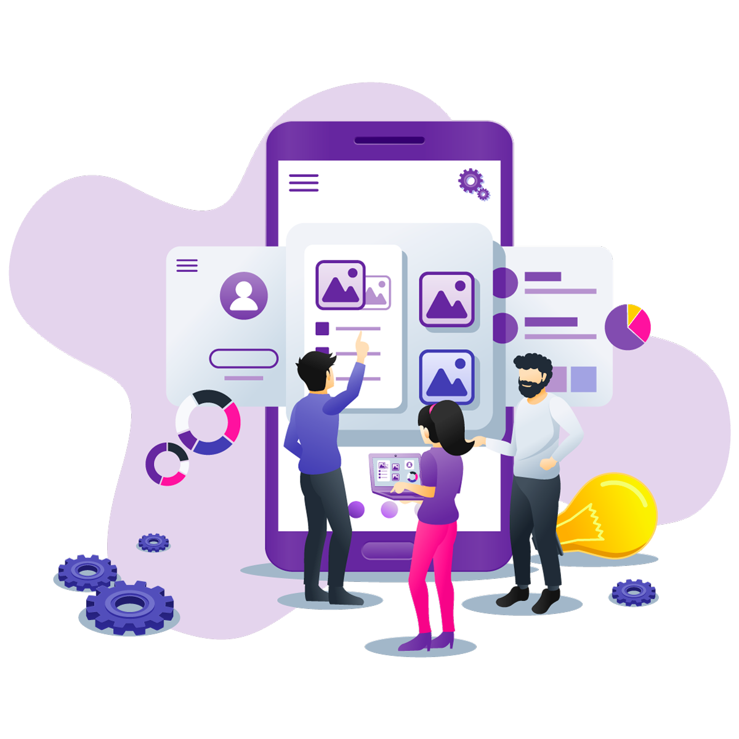

What We Selected,
Front end of an Education Website
Content
Home
Courses
Contact
About

Slide 5

Why We Selected this ,
In the session of preliminaries of web technologies, we learned HTML, CSS and JavaScript as Front-End Web Development languages.
We should use these languages practically in our exercise. therefore we decided to clone a website using these languages which has been chosen from the educational domain.
hence, we have cloned an online course website front-End UI practically as a group and got many experiences when continuing our progress as a group.

Slide 6

Development Workload Division
Home Page
Courses
Kasun Jayasanka
Mihiliya Maheshika
Contact
About Us
Amasha Weerasinghe
Malintha Kavinda

Slide 7



We’ve developed
Using,
SWIPERJS

Slide 8


External Sites that helped to styling & functions
to add Icons
to embed fonts
to get form responses

Slide 9


How We work together remotely,
We've been collaborating with each other using,
code hosting platform for version control and collaboration.
Link of the GitHub Repository
https://github.com/KasunJayasanka/PracticalExercise-Front-End.git

Slide 10

Finally,
We hosted cloned website using
Pages
https://kasunjayasanka.github.io/PracticalExercise-Front-End/

Slide 11
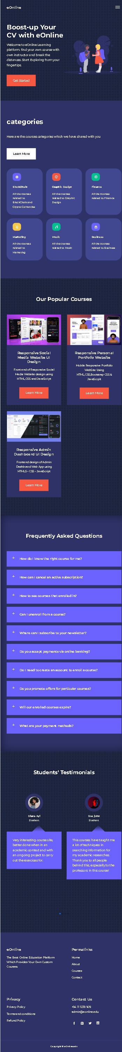
Let’s Move on to see How Our Developments Looks Like Quickly

Slide 12
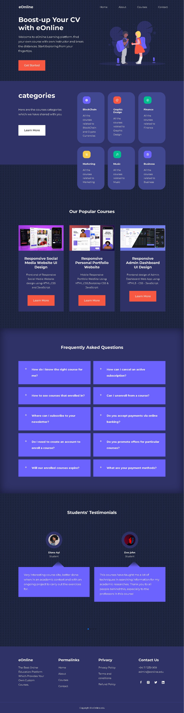
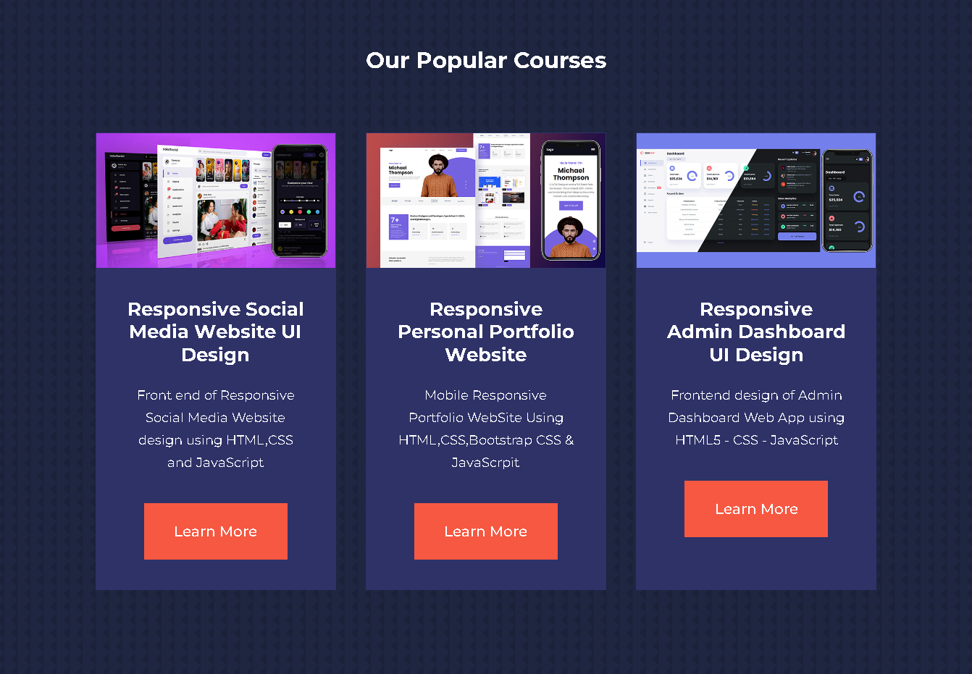

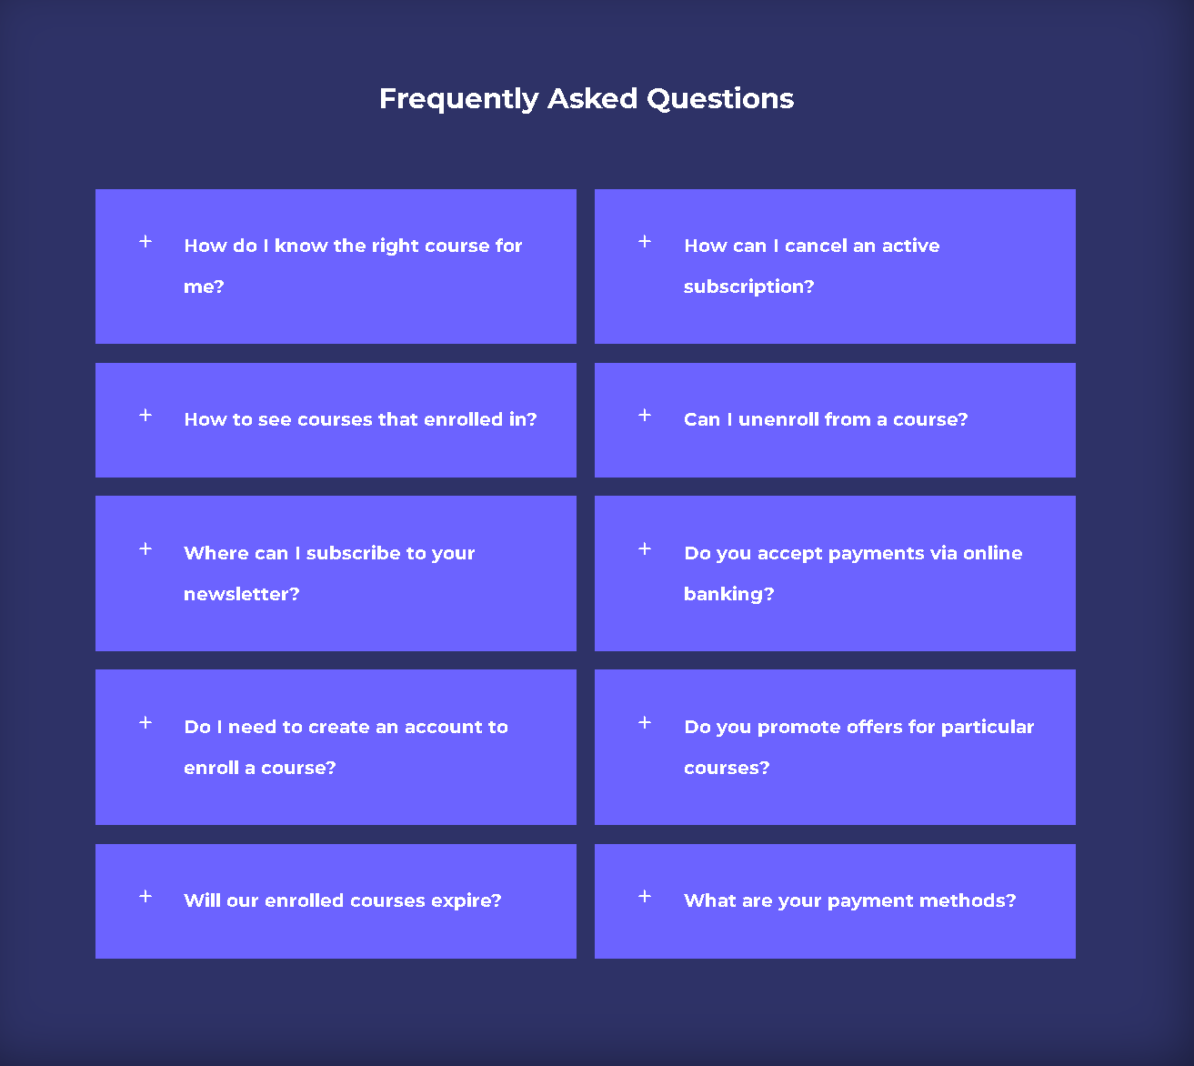
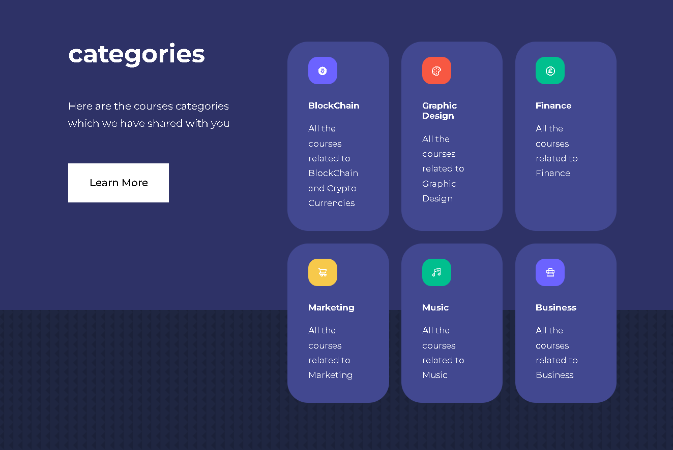
Home Page

Slide 13
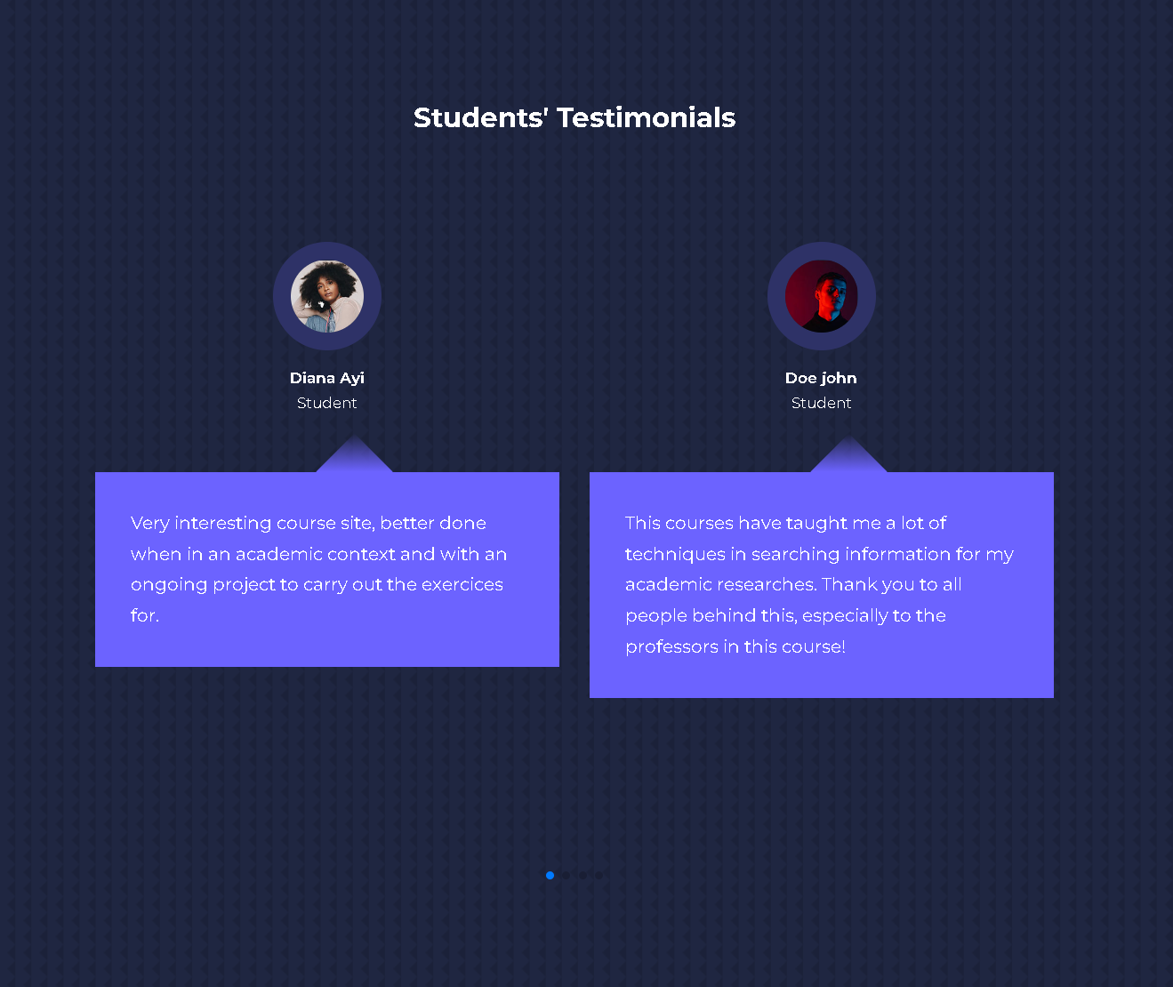

Home Page

Slide 14
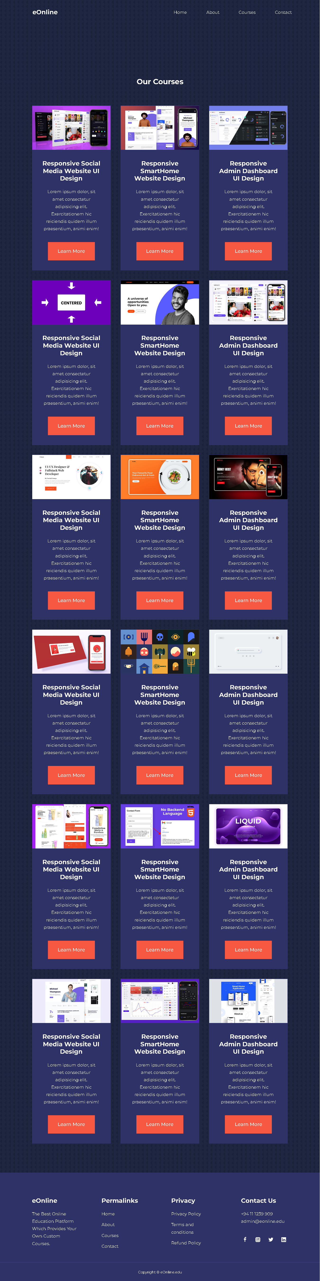
Courses
Page

Slide 15
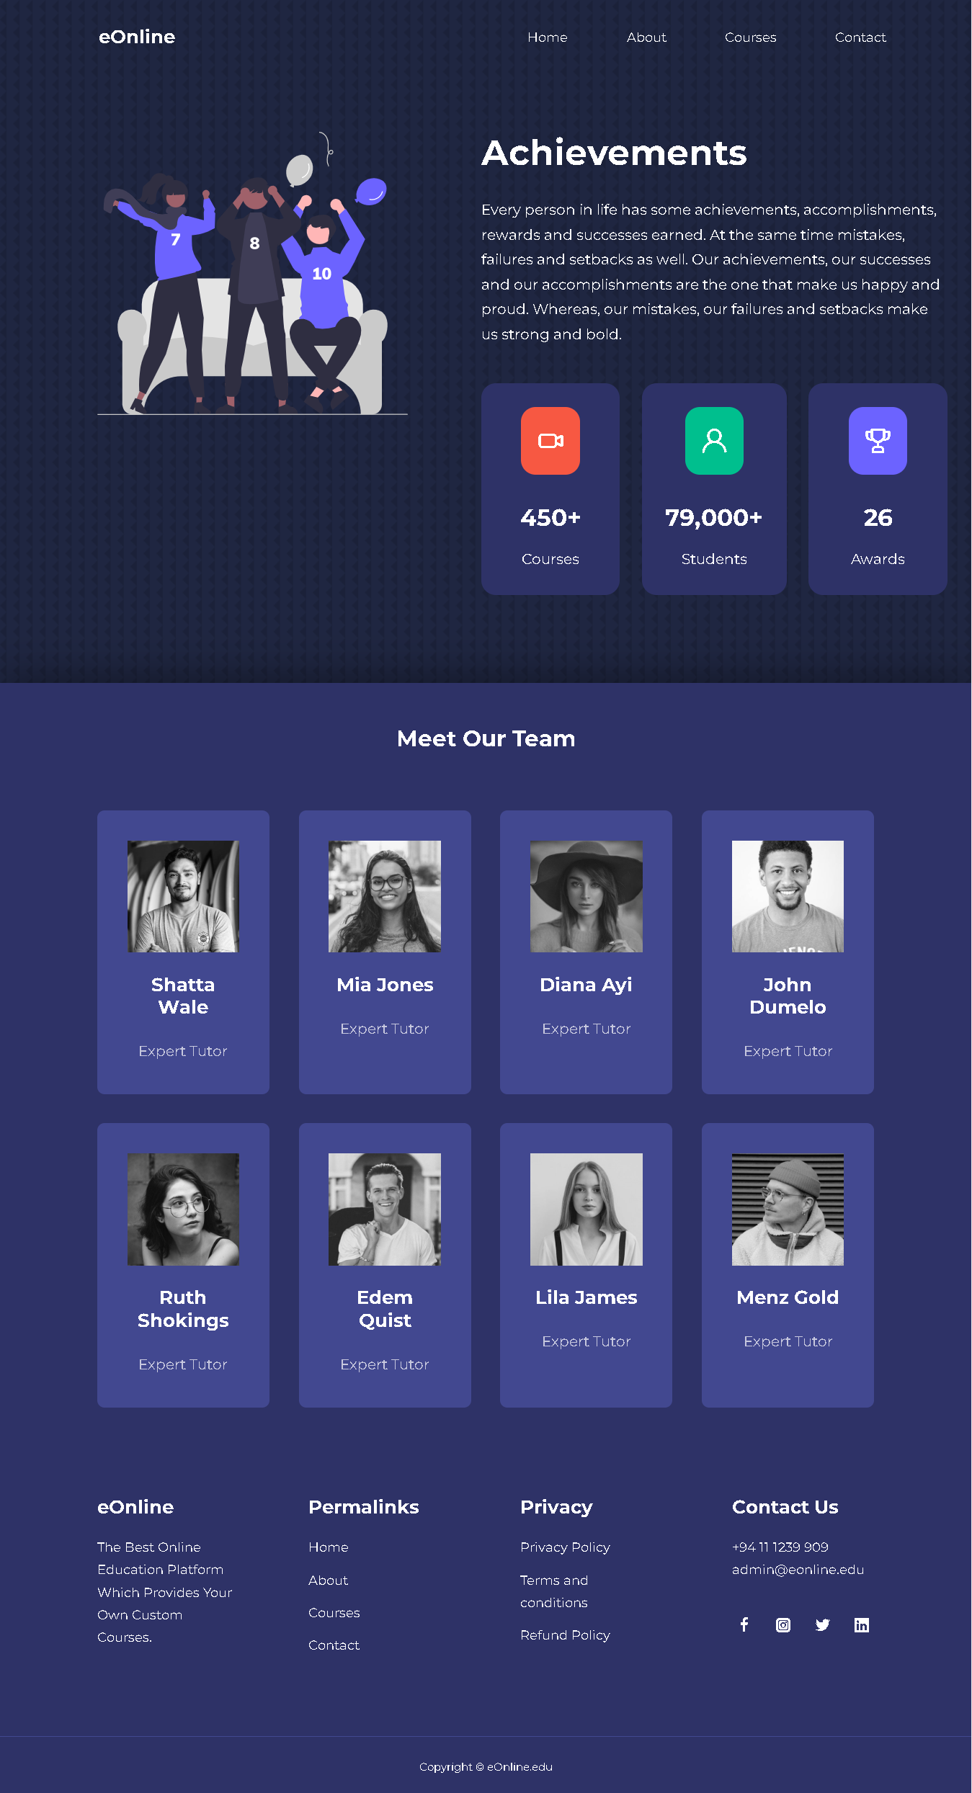
About Us
Page

Slide 16
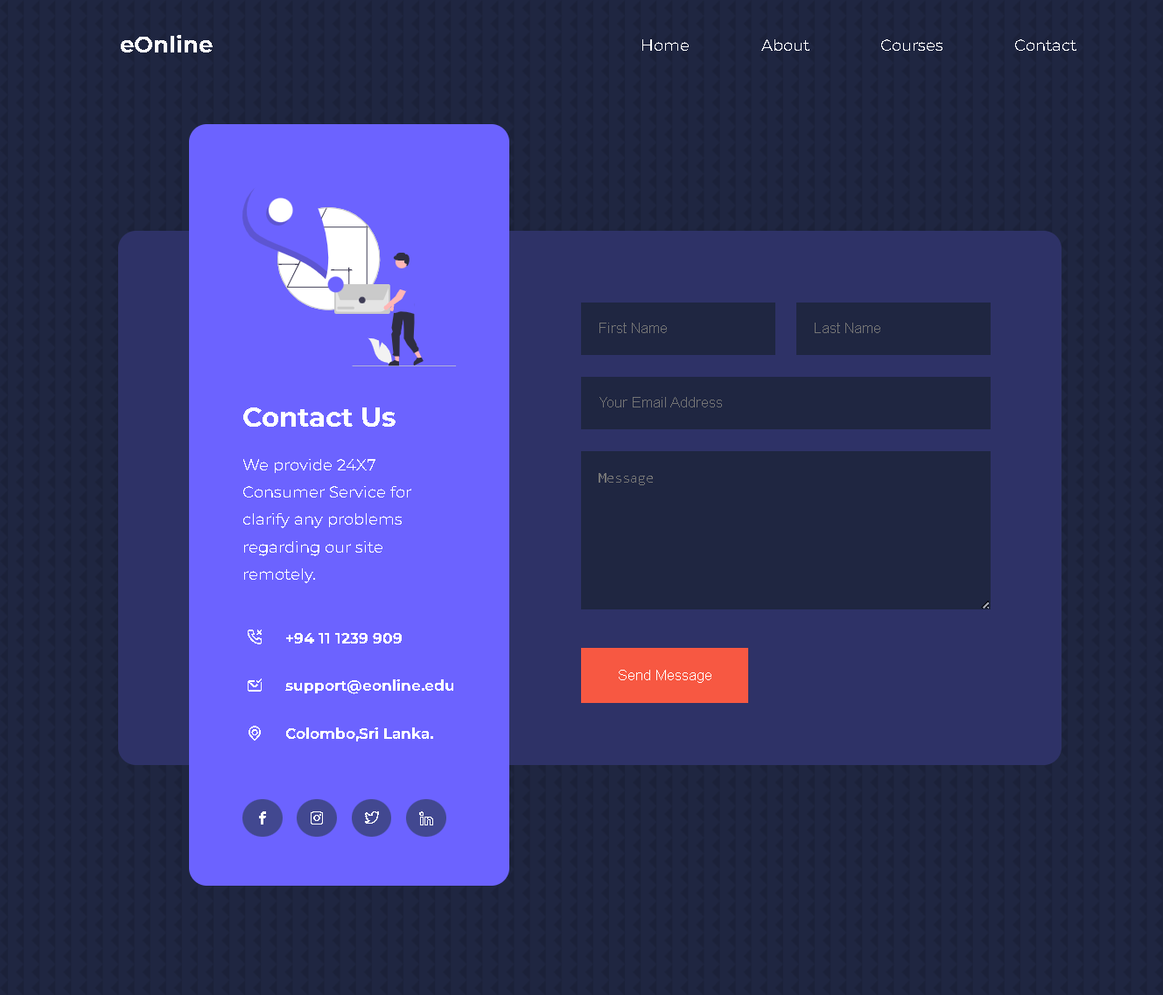
Contact
Page

Slide 17
Let’s Demonstrate our development

Slide 18

Q & A

Slide 19

Thank You!

